Slide 1
Lesson 1. Introduction to Information Security

Slide 2
Outline
What is Information Security?
Why is it important?
What can we do?
Security concepts
Summary

Slide 3
What is Information Security?
Def 1:
Information security, often referred to as InfoSec, refers to the processes and tools designed and deployed to protect sensitive business information from modification, disruption, destruction, and inspection. (Ref: Cisco.com)
Def 2:
Information security is the practice of preventing unauthorized access, use, disclosure, disruption, modification, inspection, recording or destruction of information.
(Ref: wikipedia)

Slide 4
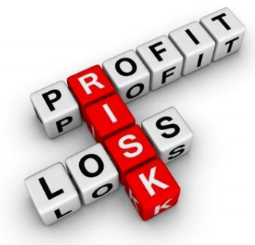
What is Information Security?
The U.S. Government’s National Information Assurance Glossary defines INFOSEC as:
“Protection of information systems against unauthorized access to or modification of information, whether in storage, processing or transit, and against the denial of service to authorized users or the provision of service to unauthorized users, including those measures necessary to detect, document, and counter such threats.”

Slide 5
What is Information Security?
Three widely accepted elements or areas of focus (referred to as the “CIA Triad”):
Confidentiality
Integrity
Availability (Recoverability)
Includes Physical Security as well as Electronic

Slide 6
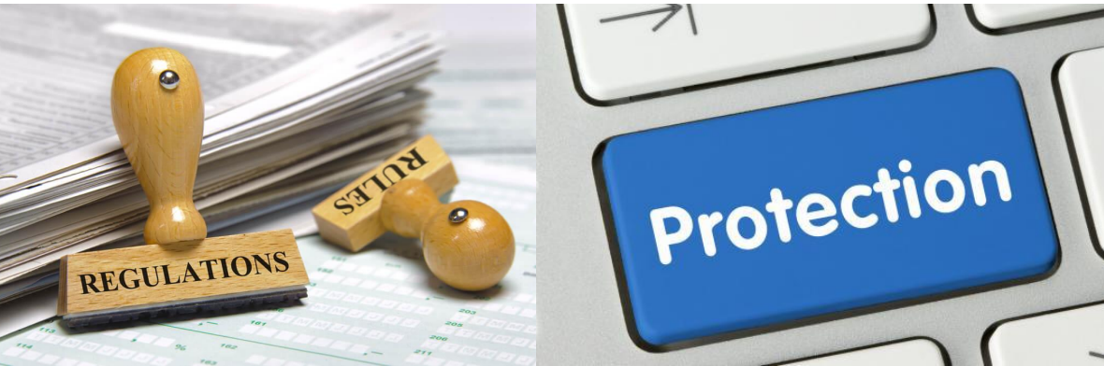
Why is InfoSec Important?
Information security is not an 'IT problem', it is a business issue.

Slide 7
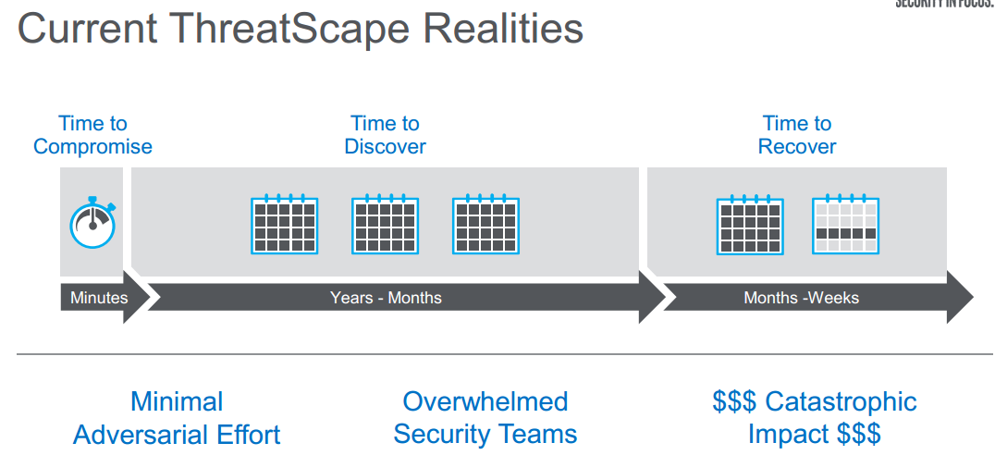
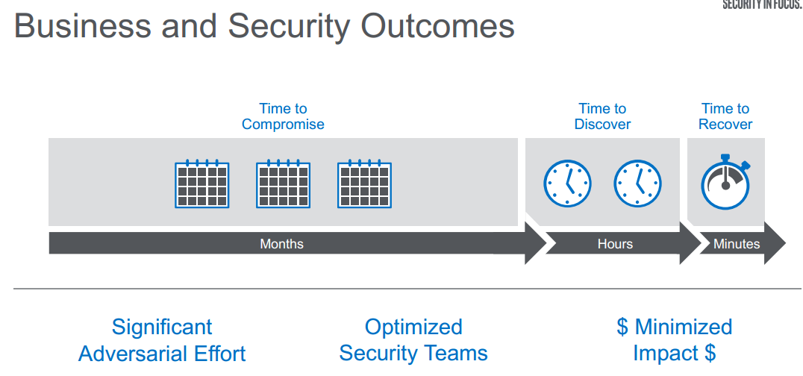

Slide 8
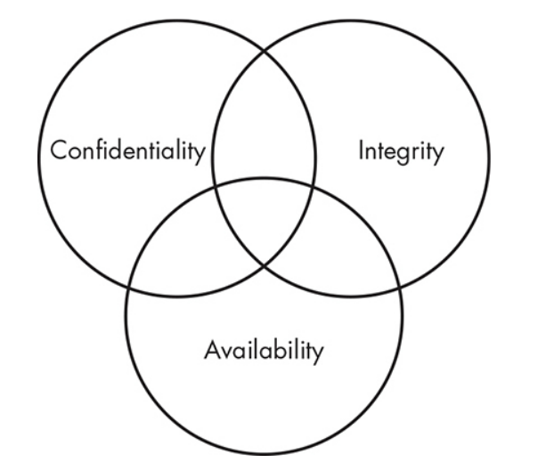
Main goals of Information Security

Slide 9

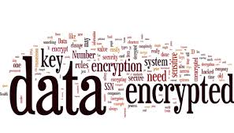
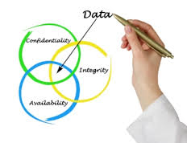
Main goals of Information Security
Confidentiality:only authorized entities have access to the data
Integrity: there are no unauthorized modifications of the data
Availability: authorized entities can access the data when and how they are permitted to do so
(C-I-A Triad)

Slide 10
Asset, Threats, Vulnerabilities, and Risk
Asset – People, property, and information. People may include employees and customers along with other invited persons such as contractors or guests. Property assets consist of both tangible and intangible items that can be assigned a value. Intangible assets include reputation and proprietary information. Information may include databases, software code, critical company records, and many other intangible items.
An asset is what we’re trying to protect.
Threat – Anything that can exploit a vulnerability, intentionally or accidentally, and obtain, damage, or destroy an asset.
A threat is what we’re trying to protect against.
Vulnerability – Weaknesses or gaps in a security program that can be exploited by threats to gain unauthorized access to an asset.
A vulnerability is a weakness or gap in our protection efforts.
Risk – The potential for loss, damage or destruction of an asset as a result of a threat exploiting a vulnerability.
Risk is the intersection of assets, threats, and vulnerabilities.
A + T + V = R
Notes:
Example: In a system that allows weak passwords,
– Vulnerability---password is vulnerable for dictionary or exhaustive key attacks
– Threat---An intruder can exploit the password weakness to break into the system
– Risk---the resources within the system are prone for illegal access/modify/damage by the intruder.

Slide 11
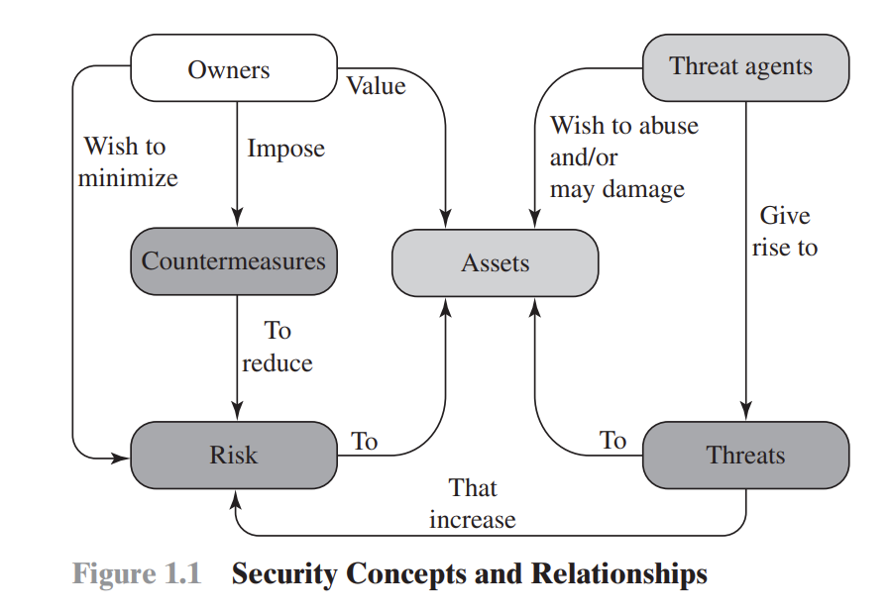
Asset, Threats, Vulnerabilities, and Risk

Slide 12
What can we do?
Security Assessment
Identify areas of risk
Identify potential for security breaches, collapses
Identify steps to mitigate
Security Application
Expert knowledge (train, hire, other)
Multi-layered Approach (there is no single solution)
Policies and Procedures

Slide 13
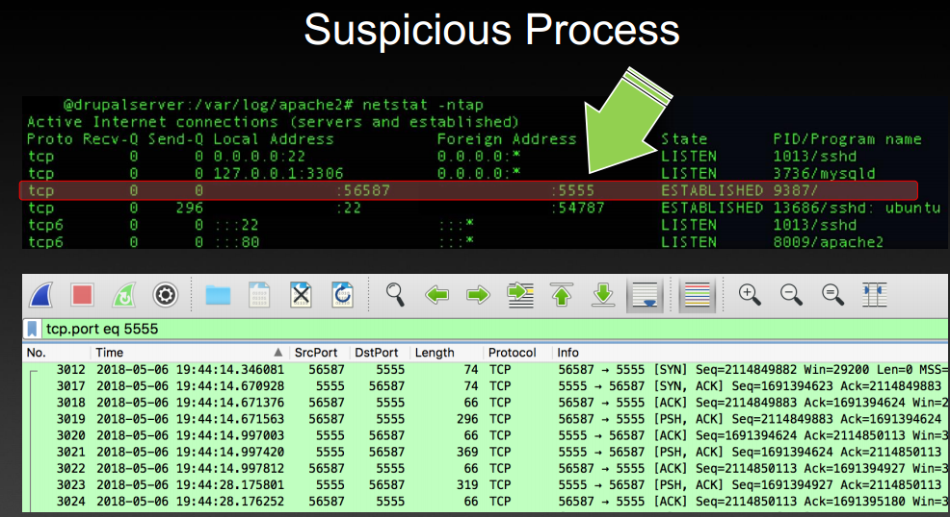
What can we do?
Security Awareness
Not just for the geeks!
Security Training at all levels (external and/or internal)
Continuing education and awareness – not a one-time shot!
Make it part of the culture

Slide 14
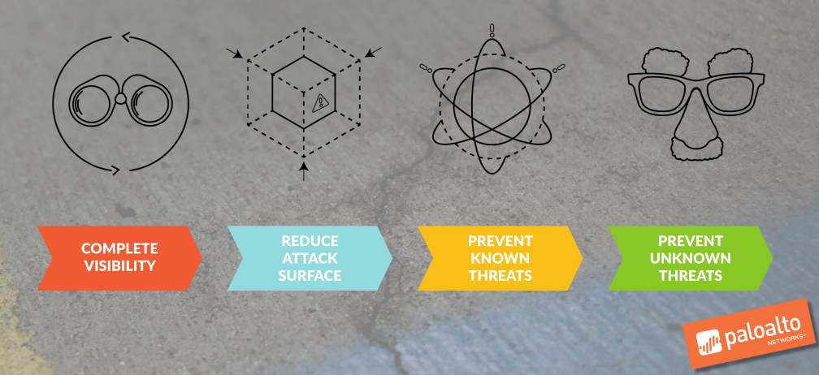
What can we do?

Slide 15
Principle of Least Privilege
Every program and every privileged user of the system should operate using the least amount of privileges necessary to complete the job

Slide 16
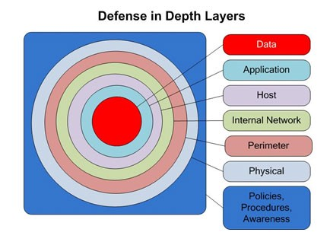
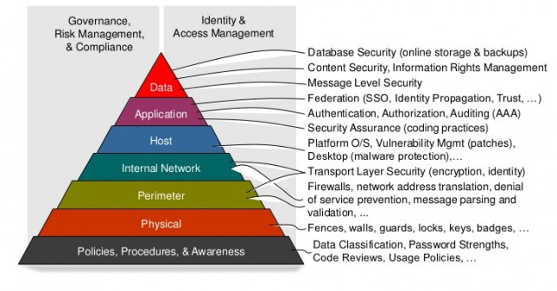
What can we do?
Defense in depth

Slide 17
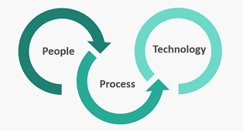
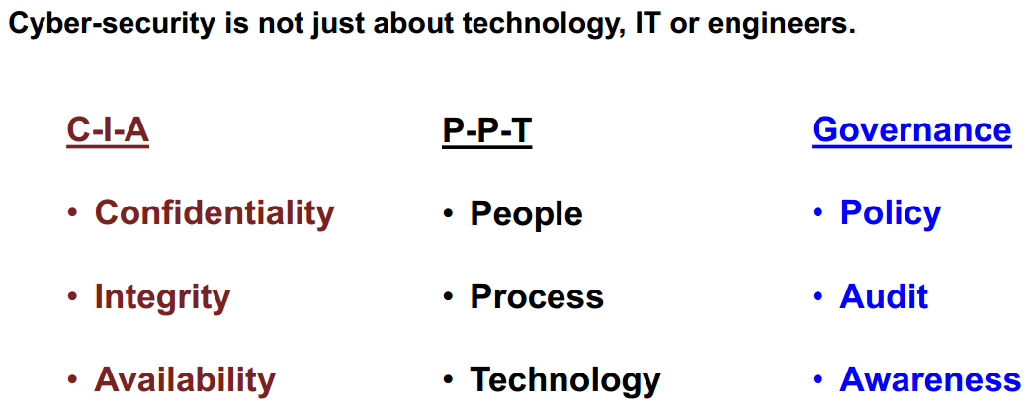
What can we do?

Slide 18
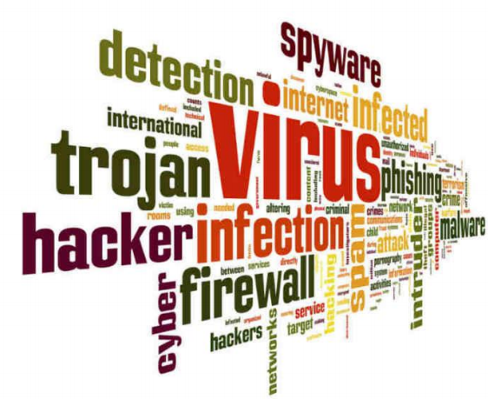
Security Concepts
Authentication
Authorization
Accounting
Access control
Nonrepudiation
The ability to ensure that someone cannot deny his/her actions

Slide 19
Security Control Frameworks
This is a notional construct outlining the organization’s approach to security, including a list of specific security processes, procedures, and solutions used by the organization. Some frameworks:
ISO 27001/27002
COBIT
ITIL
RMF
CSA STAR

Slide 20
Summary
Objective of InfoSec is Confidentiality, Integrity and Availability…protect your systems and your data
Threats are numerous, evolving, and their impact is costly
Security should be applied in layers (“road blocks”)
Security Awareness at all levels must be maintained
Practices: Ubuntu (cd, ls, mkdir, chmod, chown,…)

Slide 21
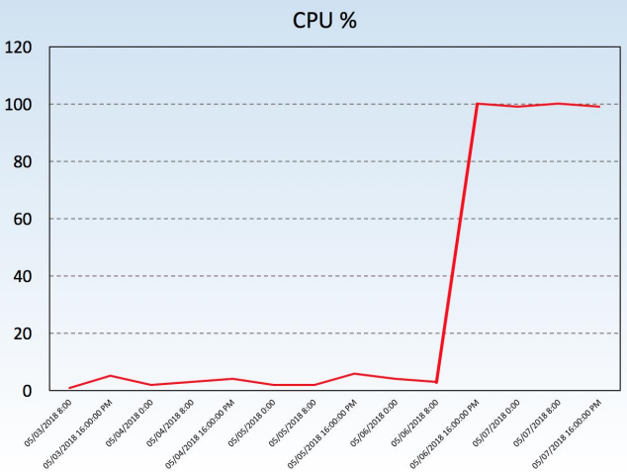
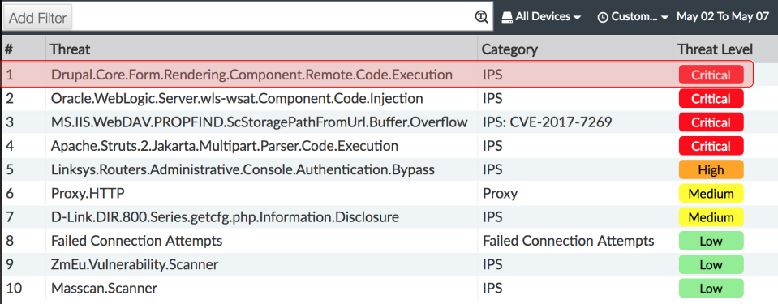
Q&A

Slide 22
Questions (MQCs)

Slide 23
Q1. Message ………..means that the data must arrive at the receiver exactly as sent
Confidentiality
Integrity
Authentication
None of the above
Answer: B

Slide 24
Q2. Cryptography does not concern itself with:
A. Availability
B. Authenticity
C. Integrity
D. Confidentiality
Answer: A

Slide 25
Q3. An access control system that grants users only those rights necessary for them to perform their work is operating on which security principle?
A. Discretionary Access
B. Least Privilege
C. Mandatory Access
D. Separation of Duties
Answer: B

Slide 26
Q4. Which of the following is the verification of a person’s identity?
Authorization
Accoutability
Authentication
Password
Answer: C

Slide 27
Q5. John is concerned about social engineering. He is particularly concerned that this technique could be used by an attacker to obtain information about the network, including possibly even passwords. What countermeasure would be most effective in combating social engineering?
SPI firewall
An IPS
User training
Strong policies
Answer: C

Slide 28
Q6. The application of which of the following standards would BEST reduce the potential for data breaches?
A. ISO 9000
B. ISO 20121
C. ISO 26000
D. ISO 27001
Answer: D

Slide 29
Q7. The first phase of hacking an IT system is compromise of which foundation of security?
Availability
Confidentiality
Integrity
Authentication
Answer: B

Slide 30
Q8. The PRIMARY purpose of a security awareness program is to?
A. Ensure that everyone understands the organization's policies and procedures.
B. Communicate that access to information will be granted on a need-to-know basis.
C. Warn all users that access to all systems will be monitored on a daily basis.
D. Comply with regulations related to data and information protection.
Answer: A

Slide 31
Q9. Which type of cyber attack is commonly performed through emails?
Trojans
Phishing
Worms
Ransomware
Answer: B

Slide 32
Q10. The use of strong authentication, the encryption of Personally Identifiable Information (PII) on database servers, application security reviews, and the encryption of data transmitted across networks provide
A. Data integrity.
B. Defense in depth.
C. Data availability.
D. Non-repudiation.
Answer: B

